Slide 1
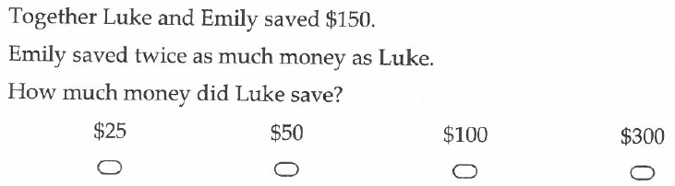
Start up Questions
If I survey a classroom on the distant they travel to get to school, am I getting categorical, numerical and discrete or numerical and continuous data?
What is the size of angle G?
If I travel for 450km in 5 hours, what is my rate of travel in km/h?
G
135º

Slide 2

Data Collection
Quickwrite:
What are the different ways we can measure someone’s height and how can we display this data?
Notes:
hook

Slide 3
Lesson objective
By the end of this lesson you will be able to;
Display data in a stem and leaf plot
- Read information from stem and leaf plots
Notes:
Lesson

Slide 4


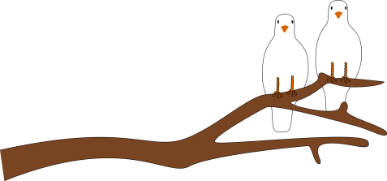
24
7
30
Date
Stem and Leaf Plot
EQ- How can I represent data in a stem and leaf plot
Questions
Notes
Explanations
How do I create a stem and leaf plot?
Put the following data into a stem and leaf plot
5, 6, 7, 8, 8, 10, 11, 11, 12, 15, 16, 17, 21, 23
Step 1: Create your key and draw up your stem and leaf plot
Step 2: Put the data into the stem and leaf plot
Step 3: Rewrite the stem and leaf plot with the numbers in order
Title
Stem
Leaves
Key: 2|3 = 23
0
1
2
5 6 7 8 8
0 1 1 2 5 6 7
1 3
Summary
5
Notes:
Non ordered data

Slide 5
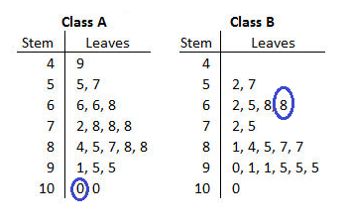
What does the circled numbers represent?
Key: 5|2=52
100 68
Notes:
Check for understanding

Slide 6
24
7
30
Date
Stem and Leaf
EQ – How can I represent data in a stem and leaf plot
Questions
Notes
Explanations
How do I find the mode from a stem and leaf plot?
Data
Look to the leaf data and identify the most frequently occurring number.
Bring the stem and leaf together for the answer.
Remember to check if there is ore than one mode.
Key: 1|2=12
0
1
2
3
5
2 8 8
2 3 6
2 5
Mode = 18
Summary
5

Slide 7
24
7
30
Date
Stem and Leaf
EQ – How can I represent data in a stem and leaf plot
Questions
Notes
Explanations
How do I find the median from a stem and leaf plot?
Data
Count the number of data points.
Add one and divide by 2. This is the position of the median.
If you get a remainder (e.g. 4.5) the median will be the average of the numbers at the two places either side of that position
Count the leaves from the top.
Key: 1|2=12
0
1
2
3
5
2 8 8
2 3 6
2 5
Median = 22
Summary
5

Slide 8
24
7
30
Date
Stem and Leaf
EQ – How can I represent data in a stem and leaf plot
Questions
Notes
Explanations
How do I find the range from a stem and leaf plot?
Data
The first leaf is the minimum.
The last leaf is the maximum.
(Make sure you include the stem).
The range is the maximum subtract the minimum.
Key: 1|2=12
0
1
2
3
5
2 8 8
2 3 6
2 5
Range = 35 – 05 = 30
Summary
5

Slide 9
Put the following data into a stem and leaf plot
5, 12, 35, 23, 22, 26, 32, 18
Data
Data
Key: 1|2=12
Key: 1|2=12
0
1
2
3
5
2 8
2 6
5 2
0
1
2
3
5
2 8
2 3 6
2 5
The data has to be in ascending order
Notes:
Guided practice

Slide 10
Practice
Page 195 in Dwyer 7
Exercise 14.6
Question 1 - 7
Notes:
Independent practice

Slide 11
24
7
30
Date
Stem and Leaf
EQ – How can I represent data in a stem and leaf plot
Questions
Notes
Explanations
Summary
Stem and leaf plots show _________________________________. We create a ________ then ___________ the data in order.
We can use stem and leaf plots to ________________________.
5

